Slide 1
Analysis and visualization
Copyright McGraw Hill, Rosen, Discrete Mathematics and its Applications

Slide 2
Dimensionality reduction
High-dimensional data (i.e., examples represented by many, many attributes) will often have simpler structure, e.g.
Topics in documents/products
Product characteristics (reliability, cost etc.)
User preferences/demographics
This simpler structure can often be approximated using a lower-dimensional representation, i.e., projecting objects into different space w/fewer attributes

Slide 3
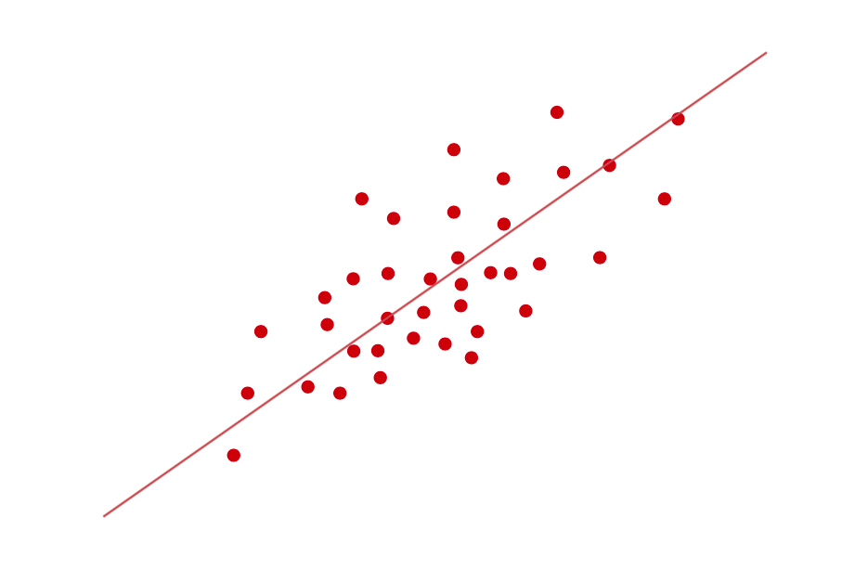
Dimensionality reduction (cont)
Usually, the data vary more strongly in some dimensions than others
Fitting a linear model to the strongest directions gives a good approximation to the data

Slide 4
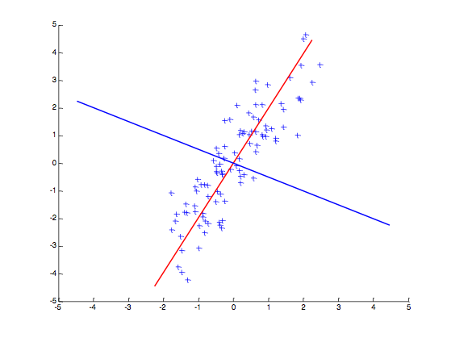
Principal component analysis (PCA)
PCA is a linear dimensionality reduction method dating back to Pearson in 1901
One of the most useful techniques in exploratory data analysis
PCA finds the directions (principal components) that maximize the variance of the data
Principal vectors are orthogonal, gives best axes to project data onto
1st principal vector
2nd principal vector

Slide 5
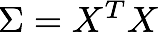
PCA: High level approach
Given data matrix X with p dimensions (attributes)
Mean center each column of X (ie. subtract from each attribute value the mean of that attribute)
Compute the p x p covariance matrix:
Find eigenvectors and eigenvalues of the symmetric covariance matrix Σ
The eigenvectors correspond to the principle components of X
Select the m eigenvectors with largest eigenvalues to reduce dimensionality

Slide 6
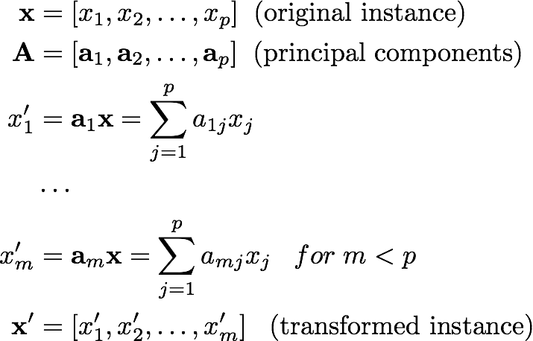
Applying PCA
New data vectors are formed by projecting the data onto the first few principal components (i.e., top m eigenvectors)
If m=p then data is transformed to new basis
If m<p transformation is lossy, dimensionality is reduced

Slide 7
How to apply PCA in python
import pandas as pd
import matplotlib.pyplot as plt
from sklearn import decomposition; from sklearn import preprocessing
# read in data and mean center
data = pd.read_csv(‘iris.dat’)
X = data.iloc[:,0:4].values
X_scaled = preprocessing.scale(X, with_std=False)
# initialize PCA model with four components
pca = decomposition.PCA(n_components=4)
# fit PCA model with scaled data and output transformed data
X_trans = pca.fit_transform(X_scaled)

Slide 8
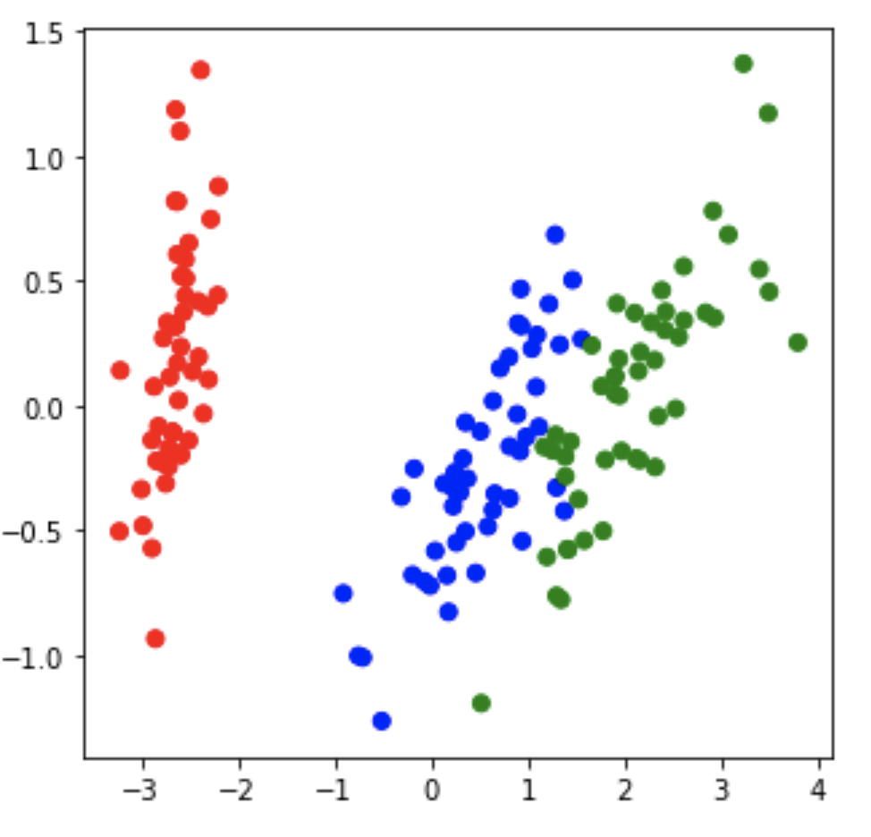
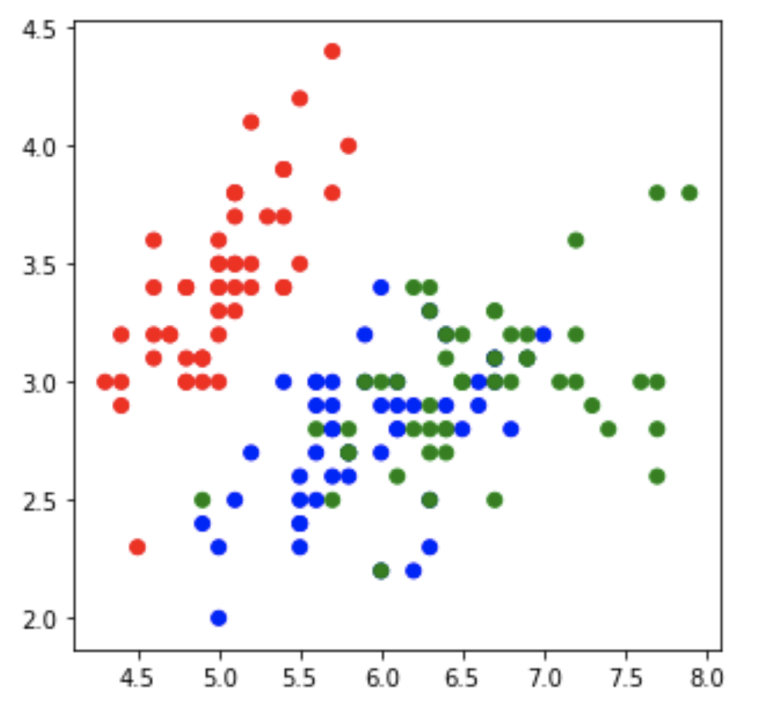
Visualizing PCA results
# map each category to a different color
data['colors']=data.category.map({'Iris-setosa':'r', 'Iris-versicolor':'b', 'Iris-virginica':'g'})
# visualize results for 1st two dimensions
plt.scatter(X_trans[:,0],X_trans[:,1],c=data[‘colors'])
# compare to 1st two dimensions in original data
plt.scatter(X[:,0],X[:,1],c=data['colors'])

Slide 9
How to choose number of dimensions
In PCA, each transformed dimension explains a proportion of the variance of the data
As m (the number of components) increases the total explained variance cannot increase
Look at the total proportion of variance explained by each dimension to choose number of dimensions
Pick number that provides a good tradeoff between accuracy (large proportion of variance explained) and complexity (small number of dimensions)

Slide 10
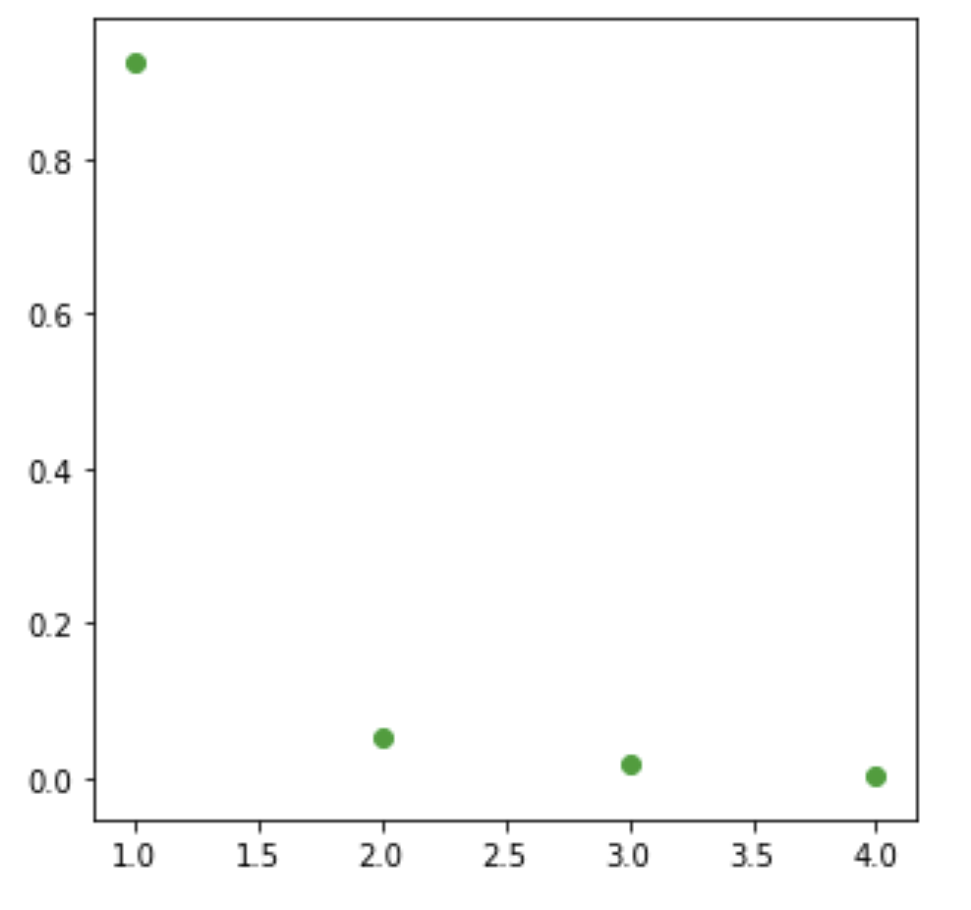
How to apply PCA (cont)
# plot explained variance vs. dimension number # to choose number of dimensions
plt.scatter(range(1,5),pca.explained_variance_ratio_)
PCA component

Slide 11
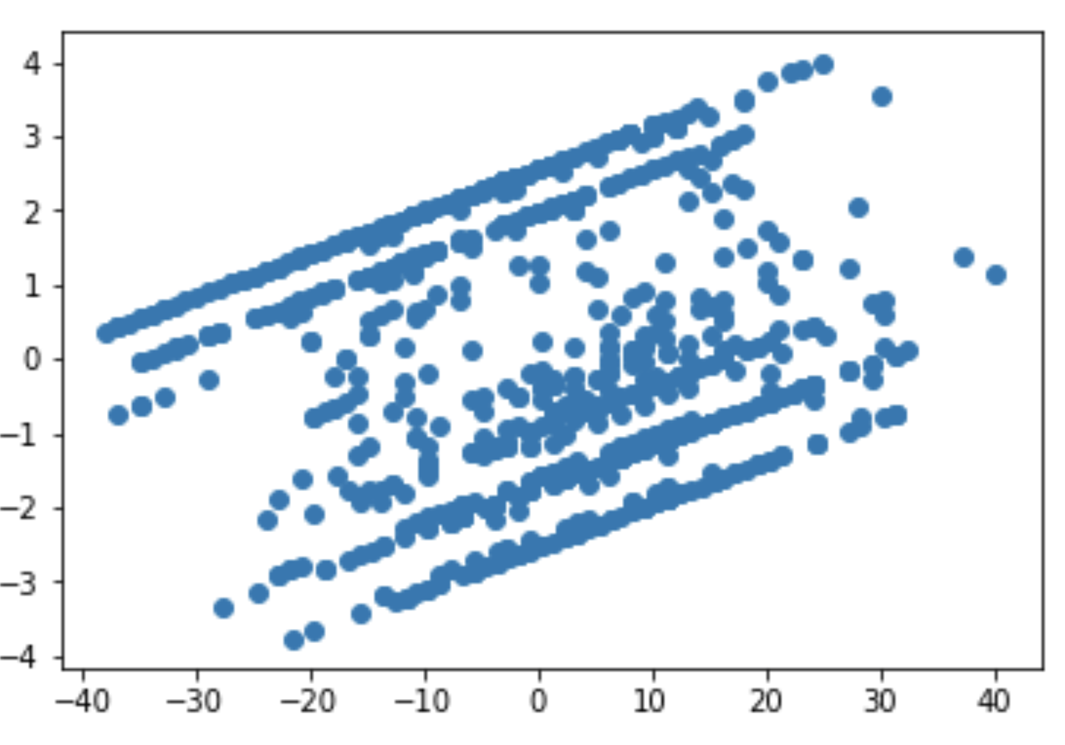
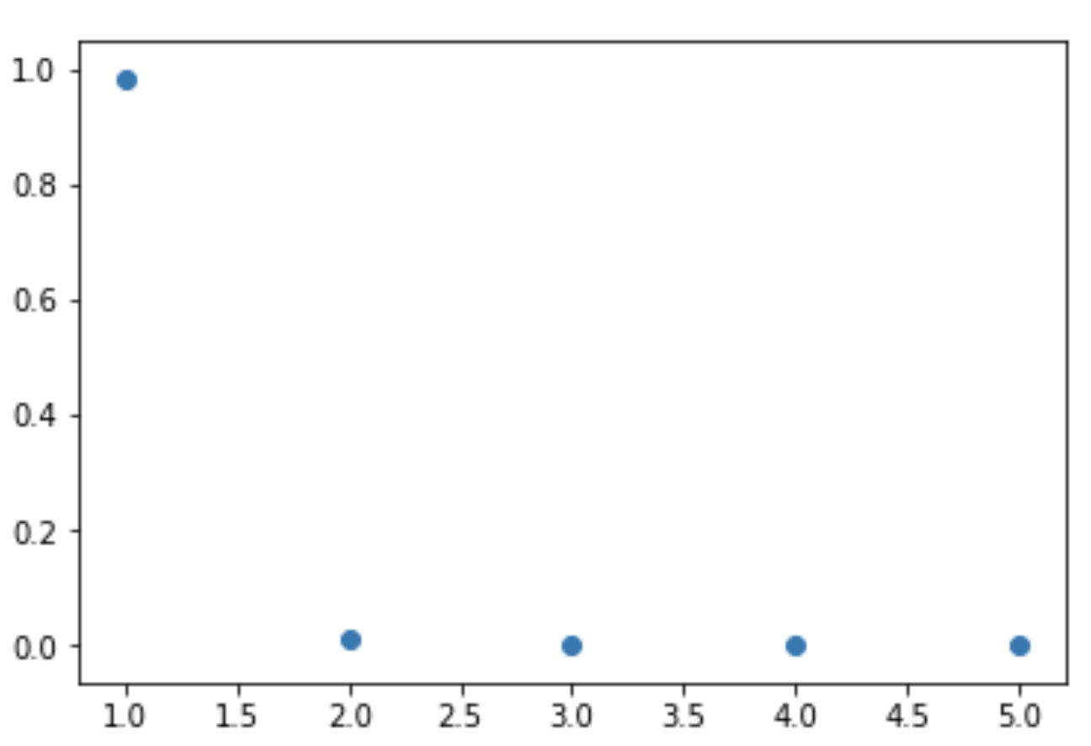
Another PCA example
data = pd.read_csv('mammographic_masses.data')
data2 = data.dropna()
X = data2.iloc[:,1:7].values
X_scaled = preprocessing.scale(X, with_std=False)
pca = decomposition.PCA(n_components=5)
X_trans = pca.fit_transform(X_scaled)
plt.scatter(X_trans[:,0],X_trans[:,1])
plt.scatter(range(1,6),pca.explained_variance_ratio_)

Slide 12
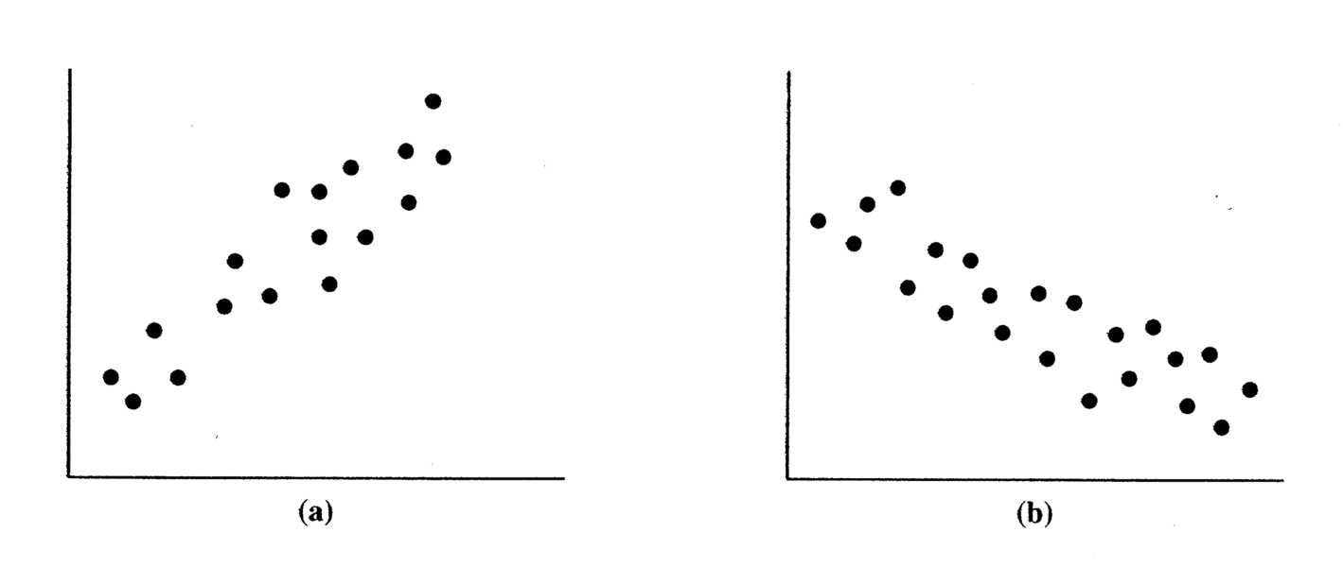
Covariance
Measures how variables X and Y vary together
Positive if large values of X are associated with large values of Y Negative if large values of X are associated with small values of Y
Covariance matrix (∑): Symmetric matrix of covariances for p variables
Note: Diagonal values record the variance of each variable
Measures linear relationship

Slide 13
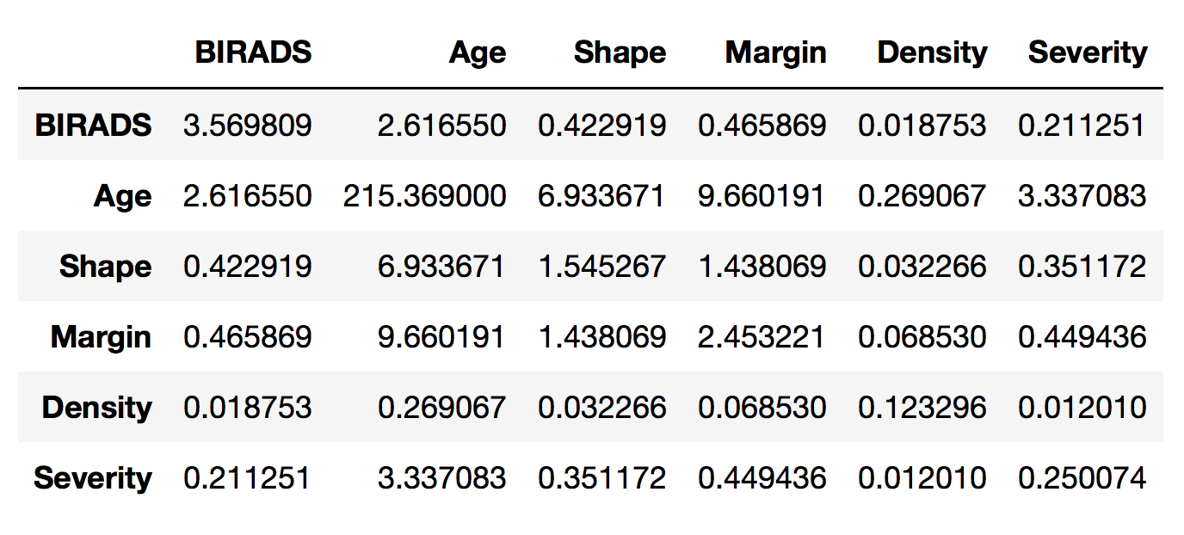
Covariance example
# covariance for mammography data
data2.cov()

Slide 14
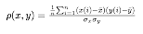
Correlation
Covariance measures the direction of the relationship between two variables, but it depends on the units of X and Y (i.e., ranges)
Correlation standardizes covariance by dividing through standard deviations
Correlation values range from +1 (max positive association) to -1 (max negative association)
Correlation matrix is similar to covariance matrix
Symmetric matrix of correlations for p variables
Diagonal values in this case are equal to 1

Slide 15
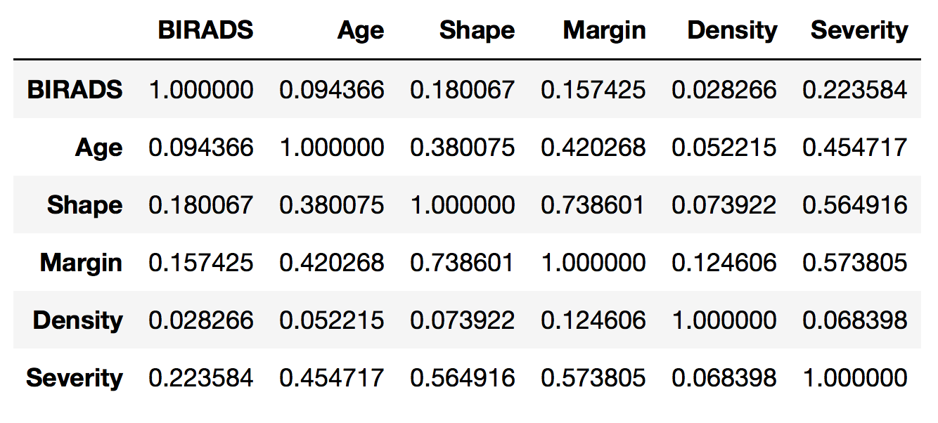
Correlation example
# correlation for mammography data
data2.corr()

Slide 16
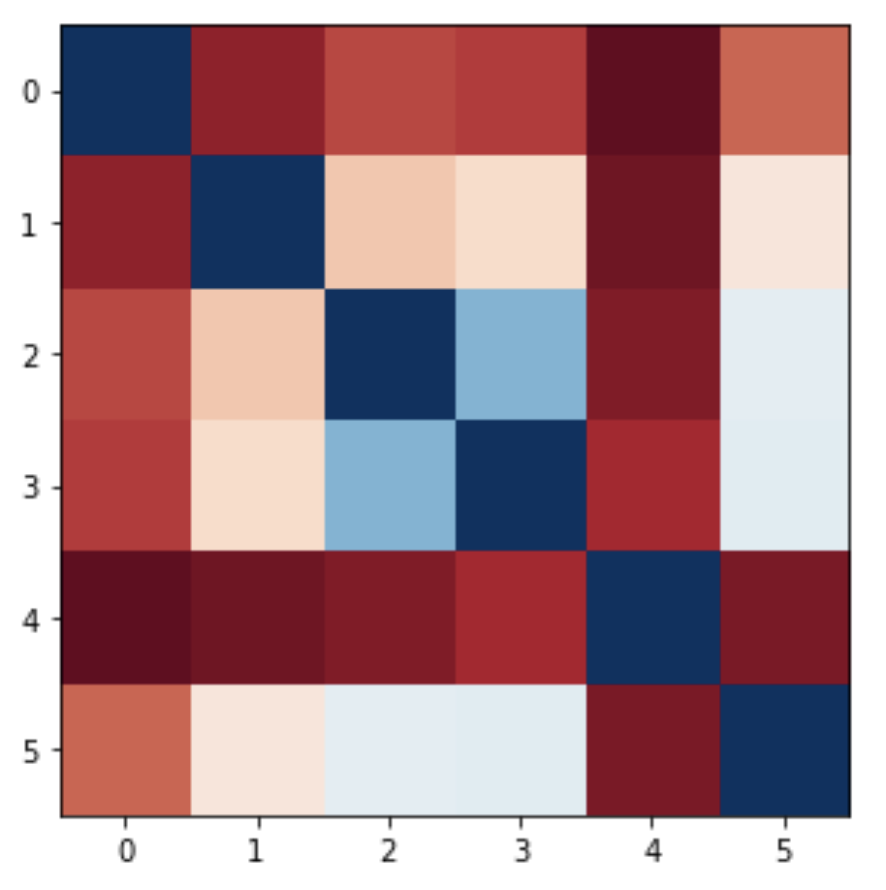
Correlation example
# visualizing correlation matrix using a divergent color map
plt.imshow(data2.corr(),cmap='RdBu')

Slide 17
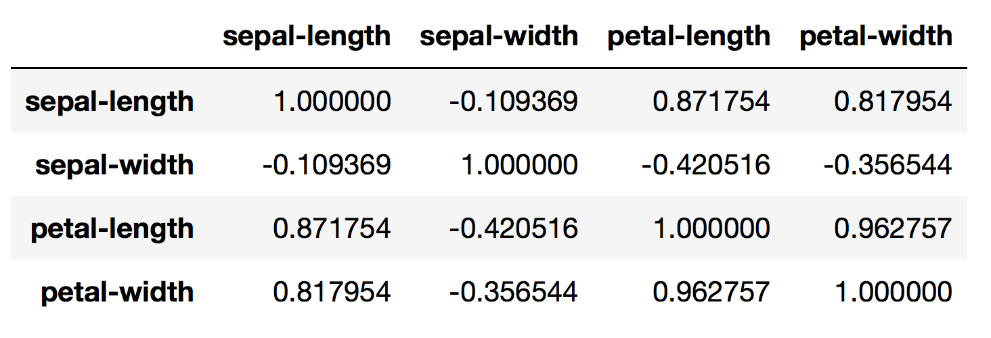
Correlation example
# correlation of iris data
data.corr()

Slide 18
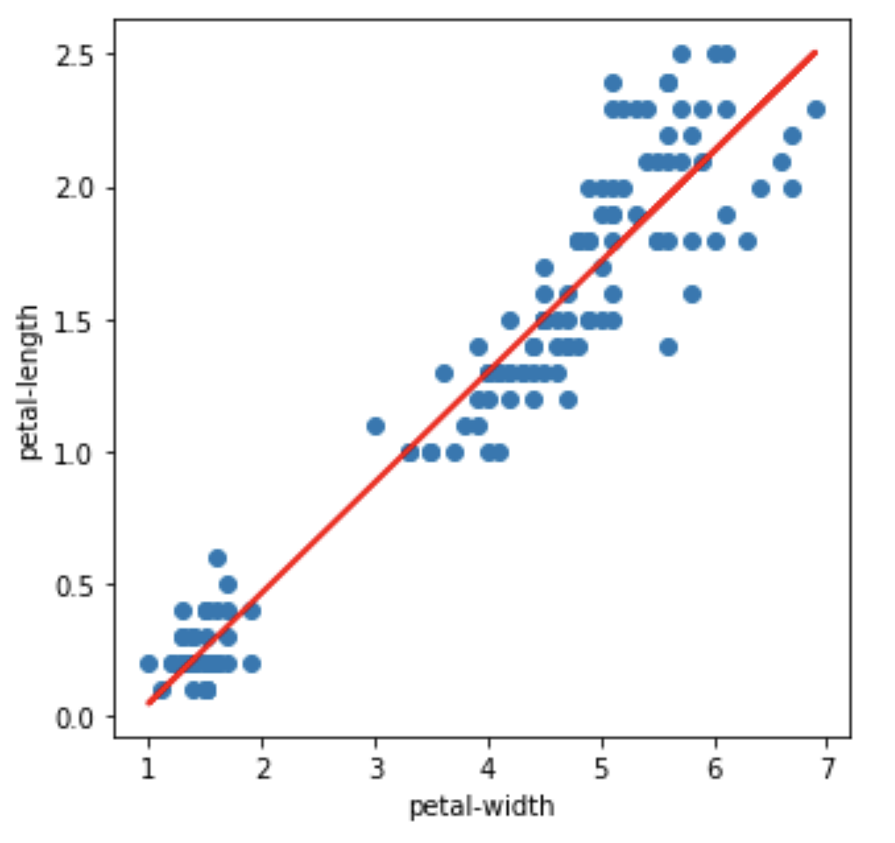
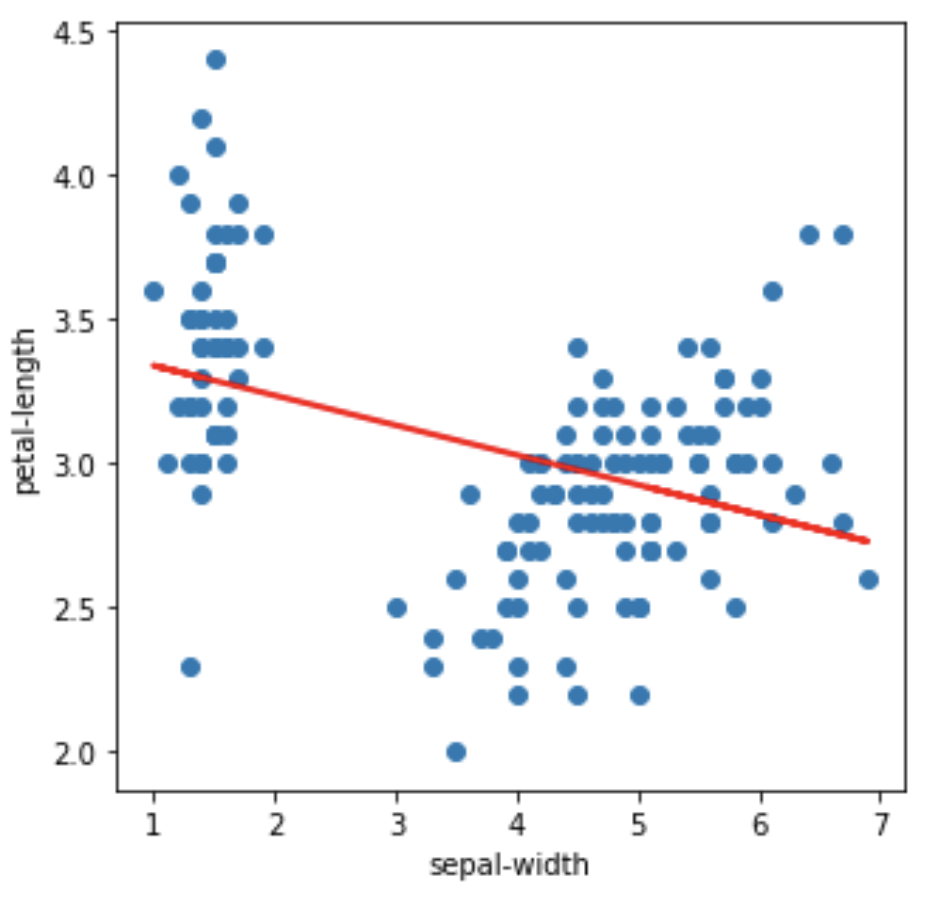
Scatterplots of correlated variables

Slide 19
Adding a fit line to scatter plots
from sklearn import linear_model
xvar = 'petal-length'
yvar = 'petal-width'
plt.scatter(data[xvar],data[yvar])
plt.ylabel(xvar)
plt.xlabel(yvar)
# Create linear regression object
regr = linear_model.LinearRegression()
# Fit the regression model using the data
regr.fit(data[[xvar]].values, data[yvar].values)
# Plot the predicted y values as a line
plt.plot(data[xvar], regr.predict(t), color='red', linewidth=2)

